Slide 1

Consumer Metrics & Shopping Behavior
End-to-End Analytics: Python · SQL · Power BI

Slide 2

Dataset at a Glance
3,900
18
Purchase Records
Data Features
37
Nulls Resolved
Review Rating imputed by category median

Slide 3

Python Data Engineering Pipeline
Load CSV
Standardize
Export
Read file and inspect schema
Convert column names to snake_case
Write cleaned data to PostgreSQL
Impute Reviews
Engineer Features
Median by category for missing values
Bin age and compute frequency
Redundant promo_code_used dropped; age binned into Young_Adult, Adult, Middle_Age, Senior.

Slide 4
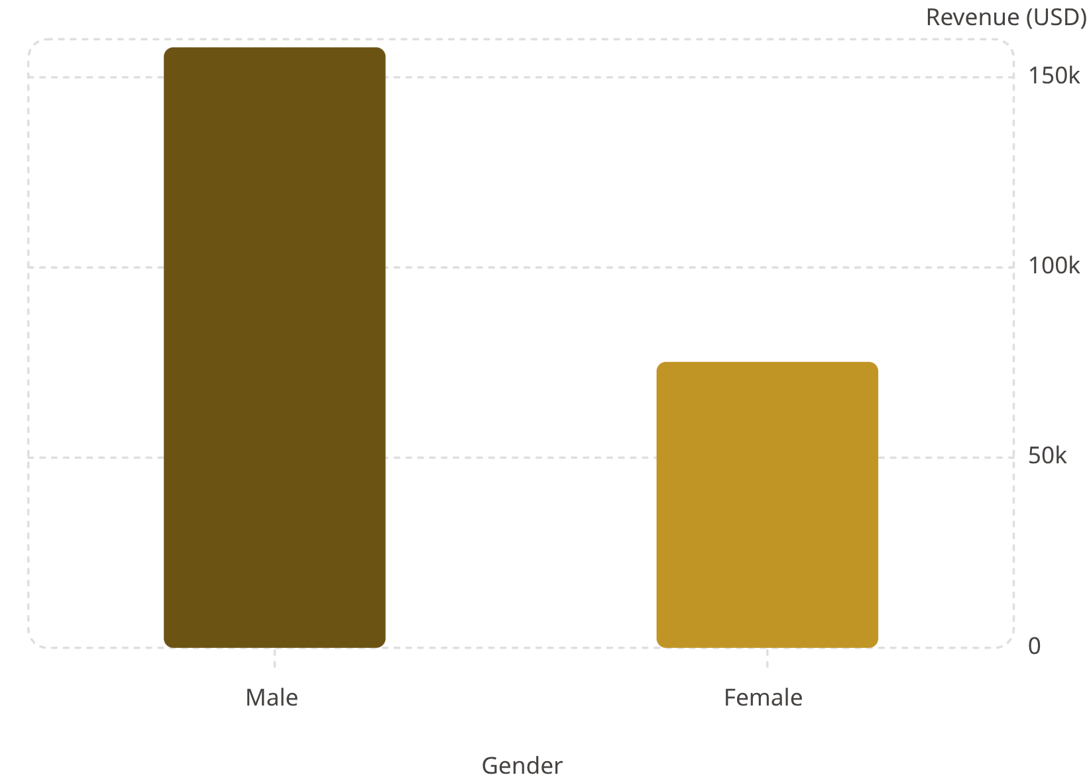

Revenue by Gender & Subscription
Subscription Revenue Split
Non-Subscribers: 2,847 clients · $170,436
Subscribers: 1,053 clients · $62,645
73% of customers remain unsubscribed — major conversion opportunity.

Slide 5
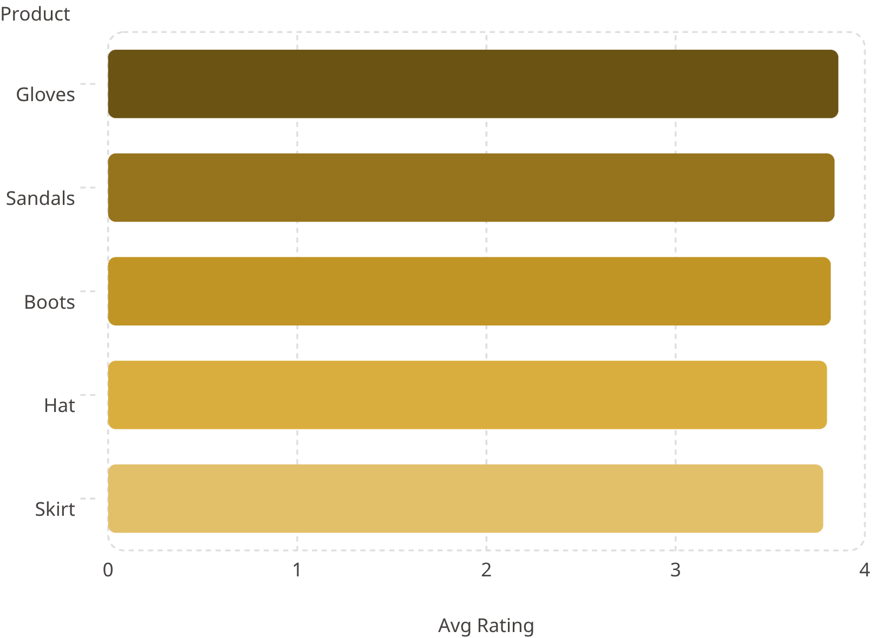
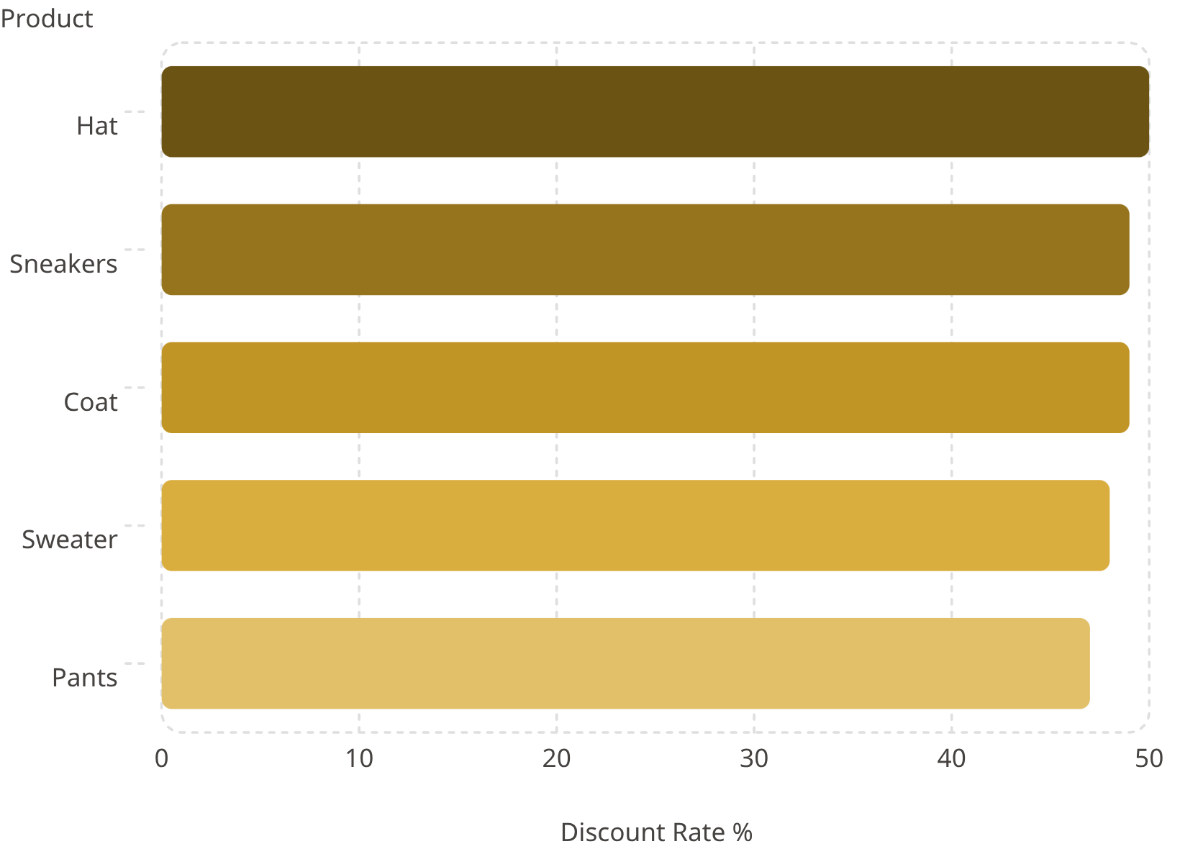
Top Products by Rating & Discount Rate
⭐ Highest Rated (out of 5)
🏷️ Most Discounted

Slide 6

Customer Lifecycle Segmentation
🔵 Loyal
🟡 Returning
3,116 clients
>10 purchases
701 clients
2–10 purchases
🟢 New
83 clients
1 purchase
Of repeat buyers (prev. purchases >5): 2,518 non-subscribers vs. 958 subscribers — untapped premium conversion pool.

Slide 7
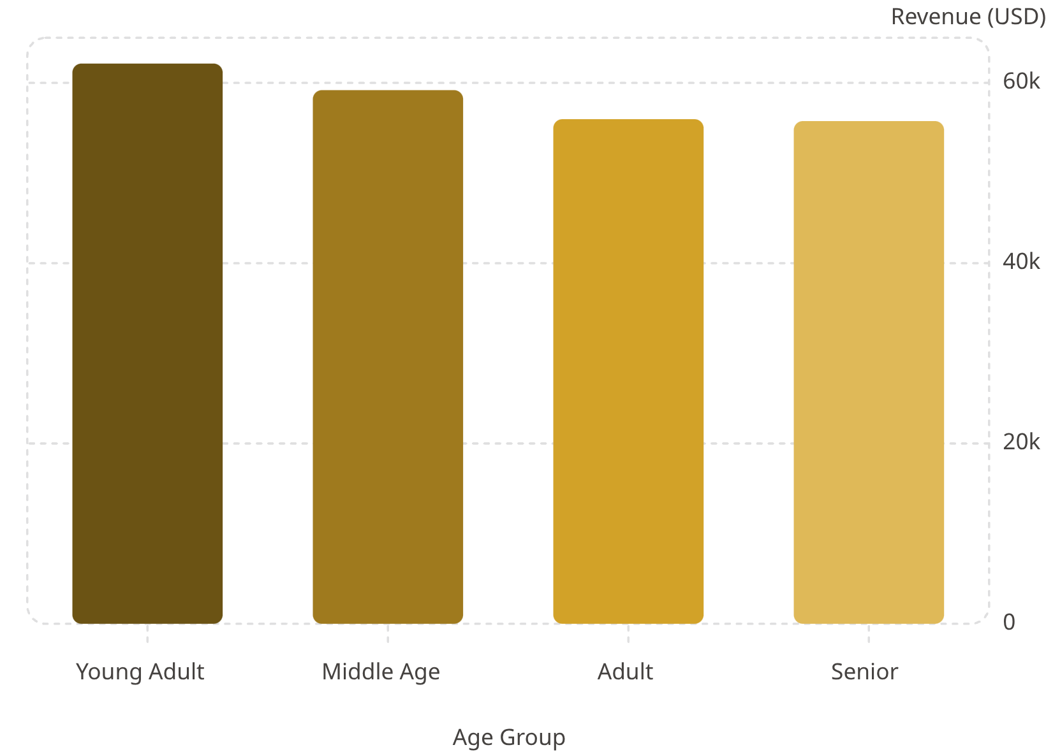
Revenue by Age Cohort
Key Insight
Young Adults lead revenue at $62,143.
Express Shipping averages $60.48 vs. Standard $58.46.
Target Young Adults with Express bundles during Fall peak.

Slide 8
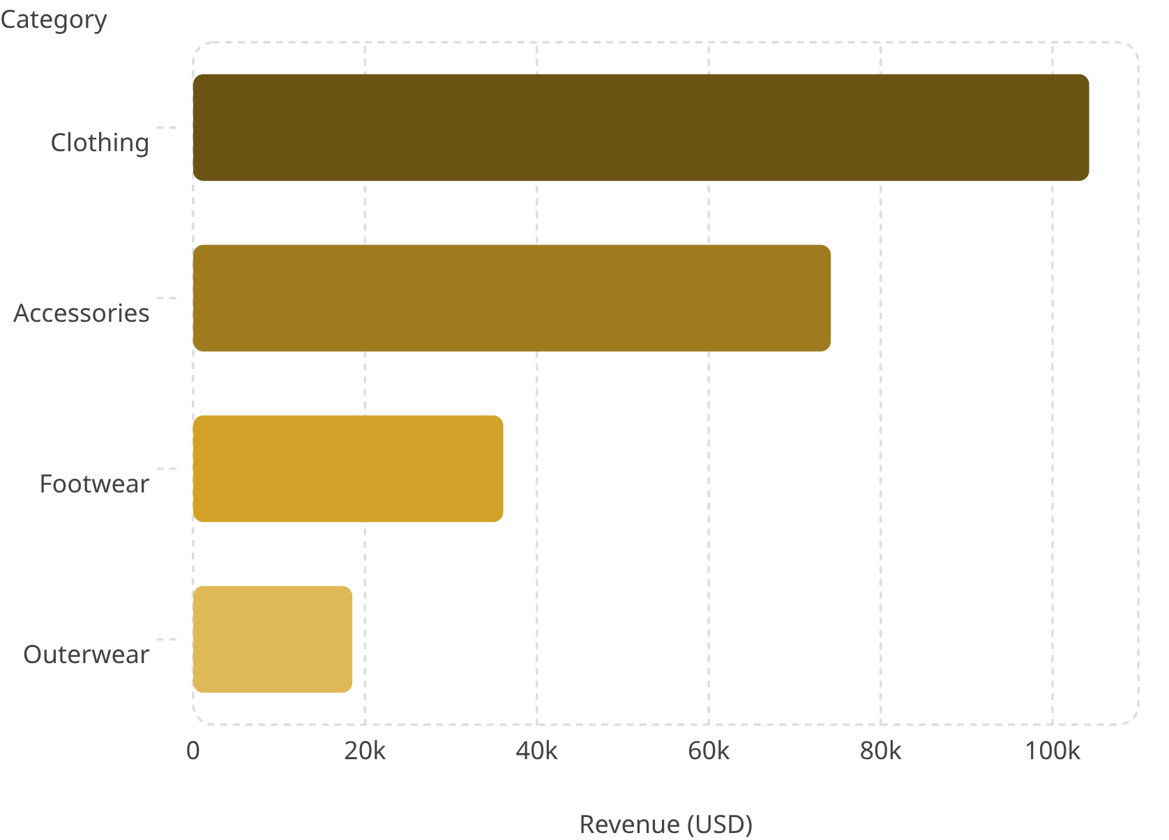
Power BI Executive Dashboard
3.9K
$59.76
Active Profiles
Avg Order Value
3.75
73%
Avg Review ★
Non-Subscribers
Category Revenue
Seasonality
Fall: $60K · Summer: $55.8K
Payments
Credit Card $40.31K · PayPal $40.11K · Cash $40K

Slide 9


Strategic Recommendations
Subscription Conversion
Loyalty Architecture
Discount Governance
Milestone rewards to convert high-frequency buyers
Threshold controls — Hat 50% promo rate erodes margin
Target 73% non-subscribers ($170K revenue) with exclusive perks
Product Positioning
Demographic Targeting
Pair top-rated items (Gloves, Sandals) with high-volume anchors
Young Adult Express bundles during Fall peak

Slide 10

Key Takeaways
Data Quality
Revenue Leaders
37 nulls resolved · PostgreSQL warehouse
Male $157K · Young Adults $62K · Clothing $104K
Growth Levers
73% non-subscribers · 2,518 loyal non-members

